Slide 1
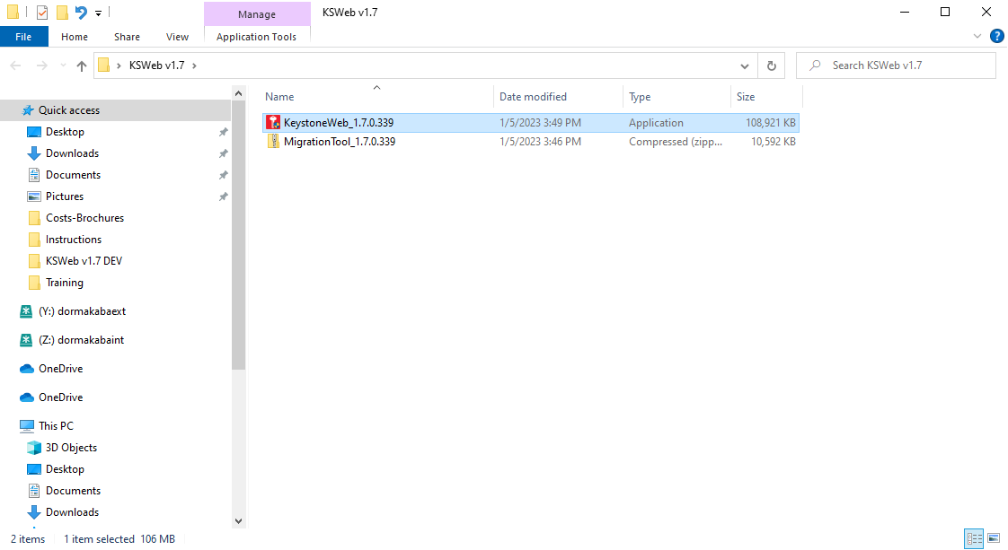
Download the installation for the Keystone Web v1.7 update from the download center. PLEASE BACKUP YOUR EXISTING KEYSTONE WEB DATABASE.

Slide 2
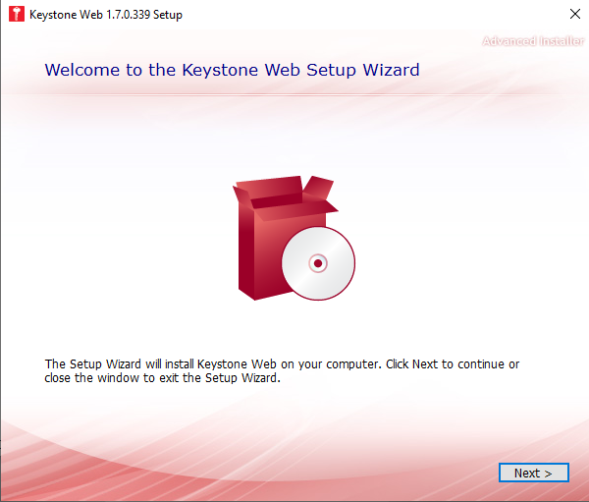
Click NEXT.

Slide 3
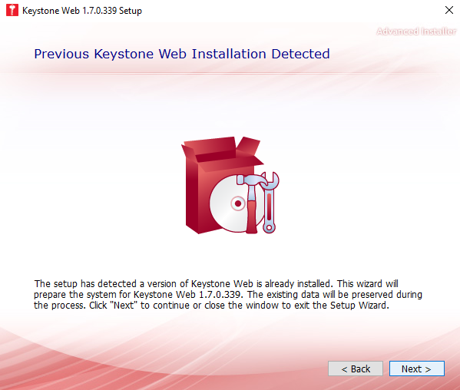
The installer should automatically detect the previous version of Keystone Web installed. Please click NEXT.

Slide 4
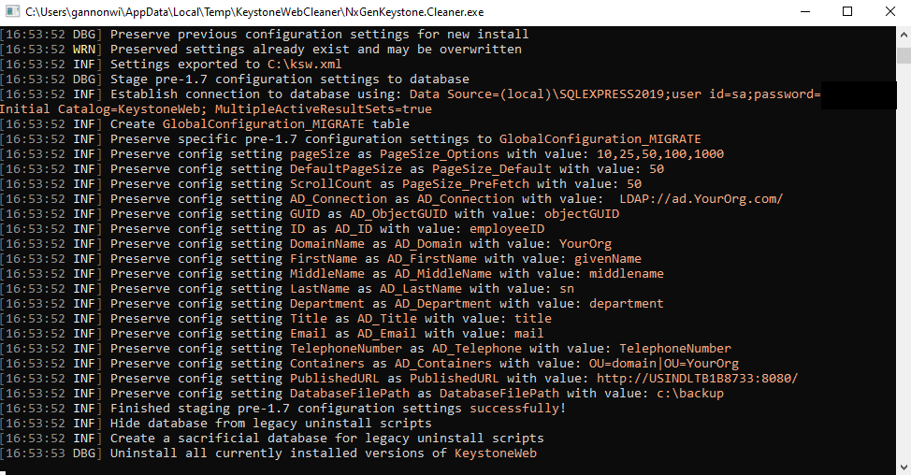
You will see the installer step through configurations and preserve your previous settings.

Slide 5
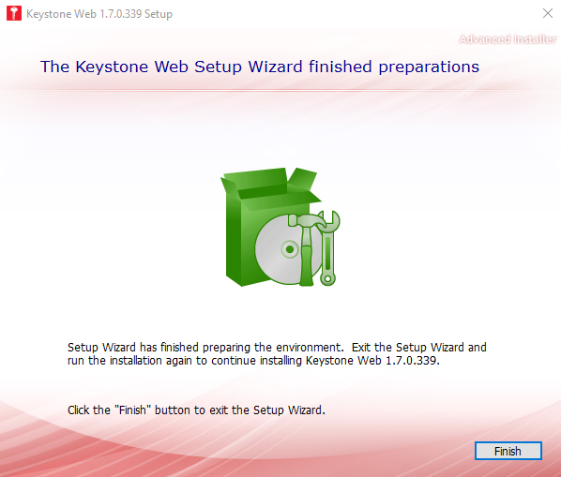
The setup will let you know that the preparations finished successfully. Click FINISH.

Slide 6
Re-launch the installer to successfully complete the Keystone Web update installation. If you are prompted to reboot your computer, please do so and re-launch the installer.

Slide 7
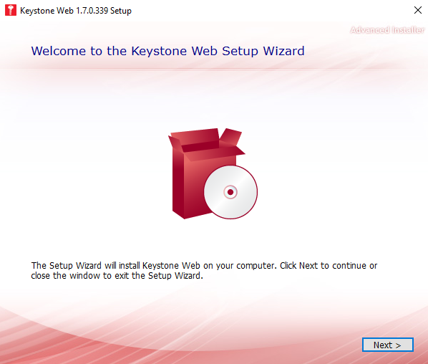
Click NEXT.

Slide 8
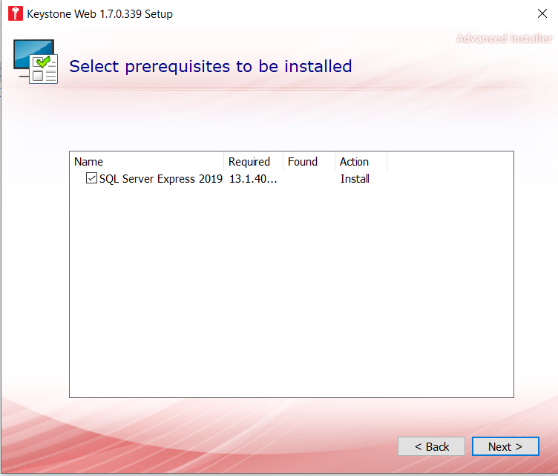
If your current database does not reside on the application server, you will be prompted to install SQL Express 2019. You can simply uncheck the box and click next.

Slide 9
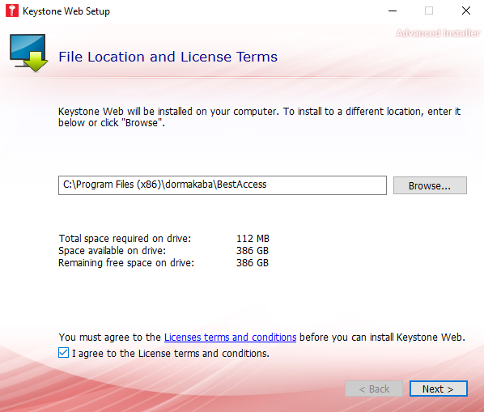
You will notice the default install path. You must agree to the Terms and Conditions before continuing with the installer. Please note the installer displays space requirements and availability.
The installer indicates the amount of free disk space available.
To continue with the installation, please check the Terms and Condition box and click NEXT.

Slide 10
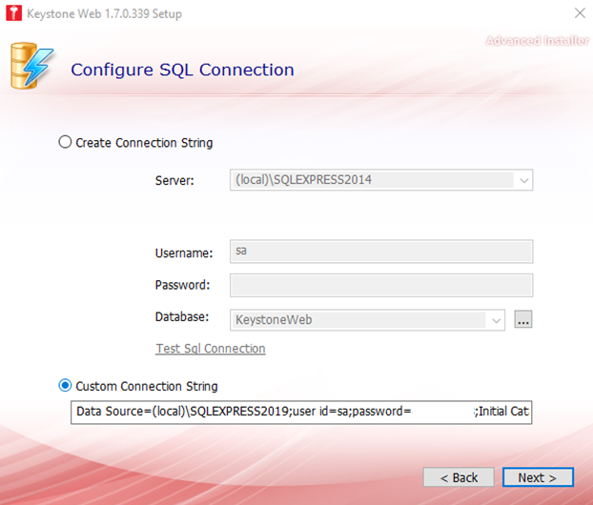
The installer will automatically detect and autofill the connection string for the current Keystone Web installation you are updating. Please note: Changing this path will result in a new Keystone Web database being created on the new path. You will not have access to the same database as your current installation. Click NEXT.

Slide 11
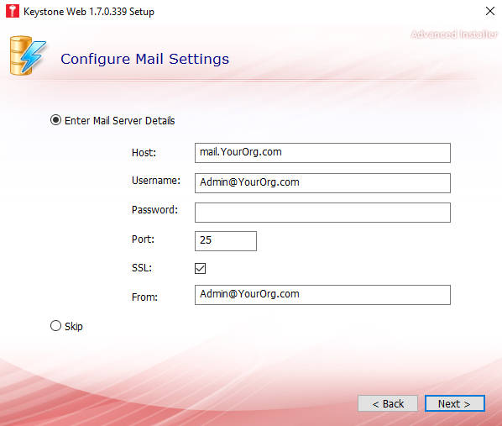
To update your email settings (Please note: If your mail settings are a part of your current installation, the settings will auto-populate in the installer.):
In the HOST box, put in your SMTP server.
Provide the login and password for the SMTP server.
25 is the default port for email servers.
Leave the SSL box checked (Recommended) unless your email server is not SSL security.
If you have an email that you have created for Keystone Web, put it in the FROM box.
If you are not using email in Keystone Web or you want to keep your current settings, click the SKIP button. Click NEXT.

Slide 12
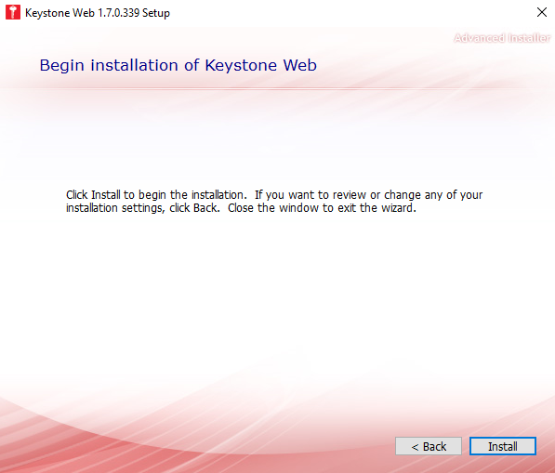
You are ready to finish the installation. Click INSTALL.

Slide 13
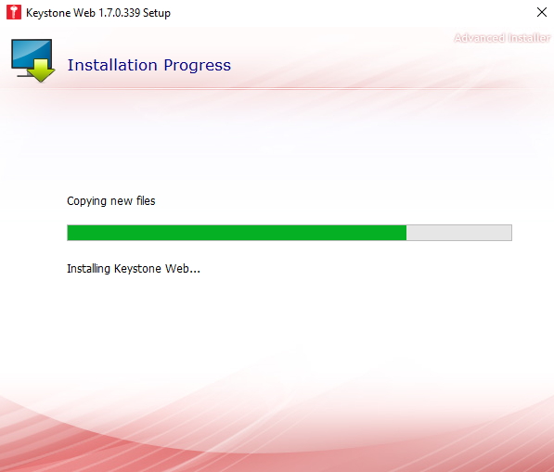
The progress bar tells you where you are in the installation.

Slide 14
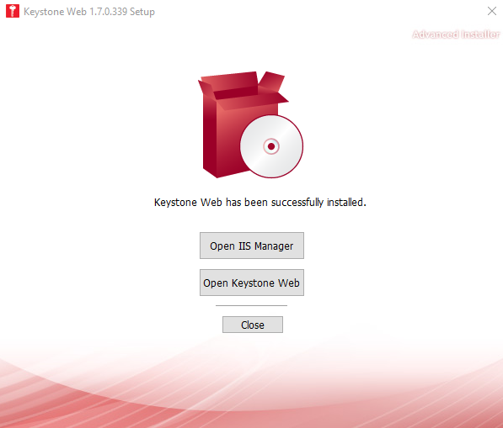
You have now completed the Keystone Web v1.7 installation. Congratulations! You can click “Open Keystone Web” to peruse your new update.

Slide 15
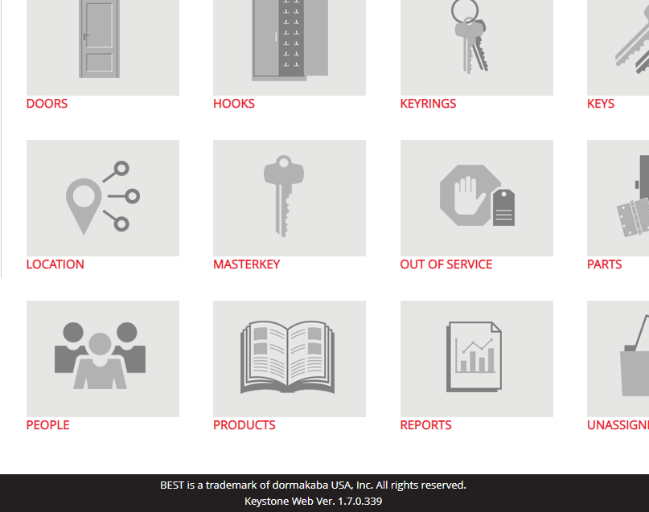
Scroll down to the bottom of the Keystone Web screen to validate the version in the black banner.

